Slide 1
Physics H3 Light
Light Sources

Slide 2
Light
After this lesson:
Explain what a direct and indirect light source is.
Recognize various light sources.
know how light travels
Notes:
2

Slide 3
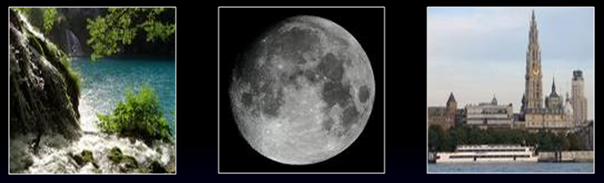
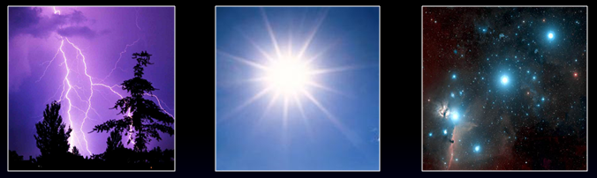
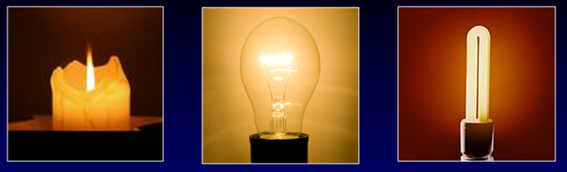
Licht bron
Light
Direct light source emits light.
  Natural light
  Artificial light source (man-made)
Indirect light such as the moon gives light reflection (reflectance).
When you put an indirect source in a box it’s dark.
Notes:
When you do the indirecct source in a box is dark – this is not clear as a sentence. Do you mean when you put the indirect light source in a box it is dark?

Slide 4
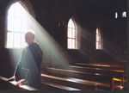

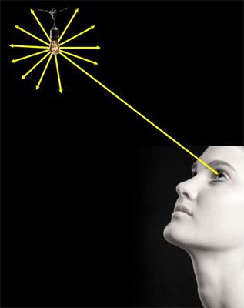
Displacement of light
light displaces along a straight line.
Light requires no medium.

Slide 5
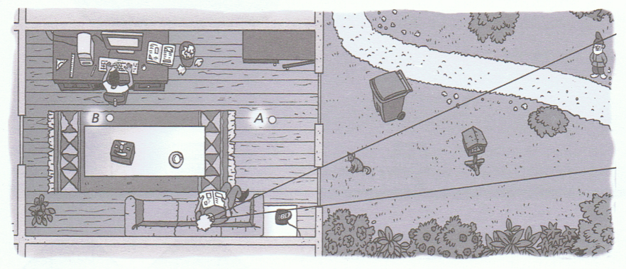
Drawing view lines

Slide 6
Drawing a light beam
Straight line
Put an arrow in the line for the direction of the light
Within mathematics it’s called a view line.
Notes:
it’s

Slide 7

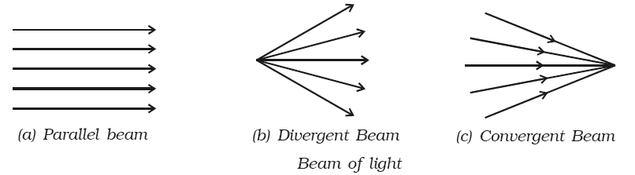
3 kinds of beams
Converging beams make connection
Parallel Divergent Convergent
Notes:
sorts

