Slide 1
Science Nova
H3 Light
Light
Light displacement

Slide 2
Physics H3 Light
After this lesson:
How light travels.
Which three kinds of light beams there are.
How you can draw a vision with viewing lines
Notes:
I’m not sure what is meant by draw a vision – is this a picture, an image or a view? Kinds.
2

Slide 3


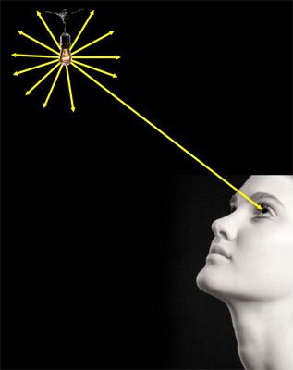
Displacement of light
light displaces along a straight line.
Light requires no medium.

Slide 4
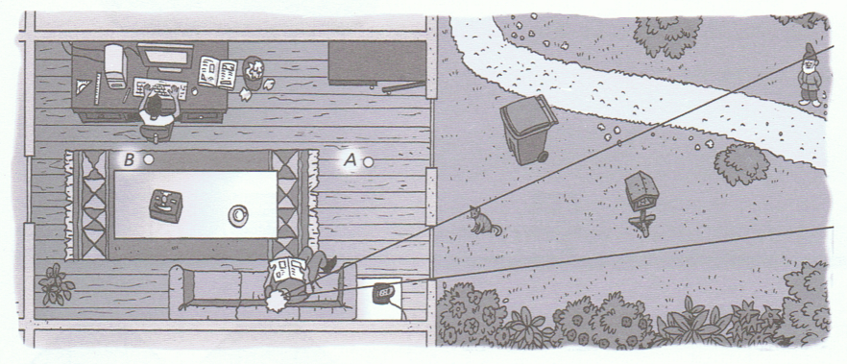
Drawing view lines

Slide 5
Drawing a light beam
Straight line
Put an arrow in the line for the direction of the light
Within mathematics it’s called a view line.
Notes:
it’s

Slide 6

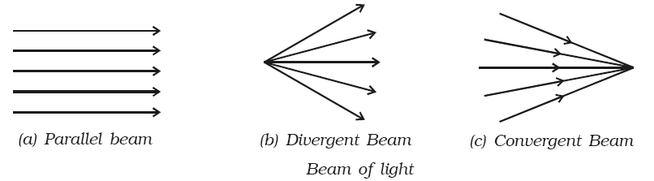
3 sorts of beams
Converging beams make connection
Parallel Diverging Converging
Notes:
sorts

