Slide 1
Physics H8 Light
When can you see a object?
What is the colour of this object?

Slide 2
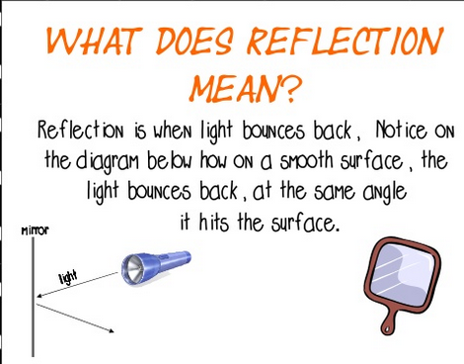
Physics H8 Light

Slide 3
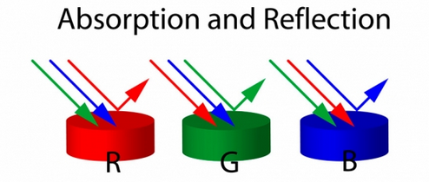
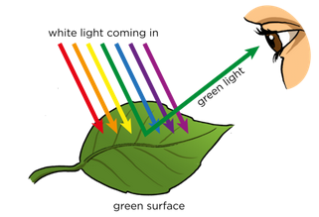
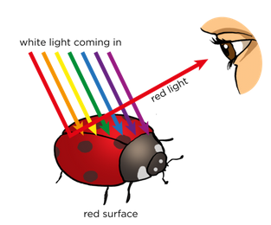
Reflection a object reflects it’s own colour
Physics H8 Light

Slide 4
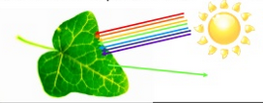
Absorbtion
Other colours will be absorbed
Physics H8 Light

Slide 5
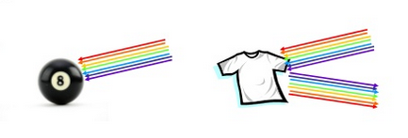
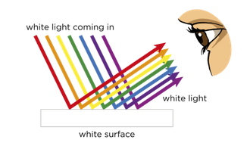
Black absorbs all colours
White reflects all colours
Physics H8 Light

Slide 6
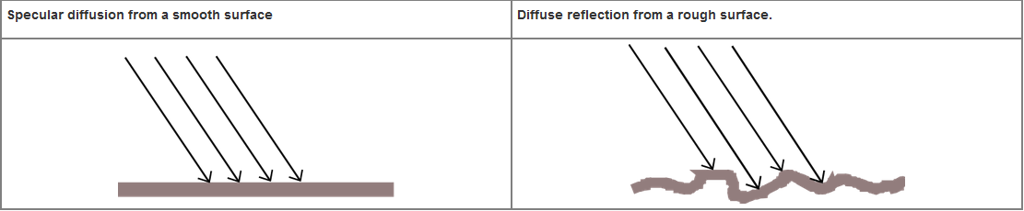
Two kinds of surfaces
Smooth Rough
Physics H8 Light

Slide 7
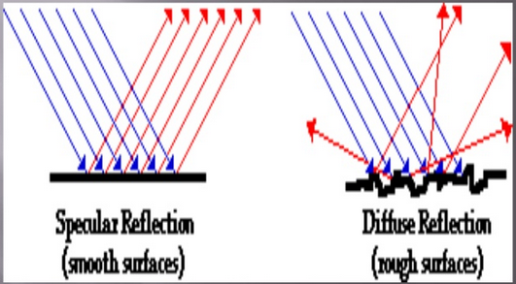
Physics H8 Light

Slide 8
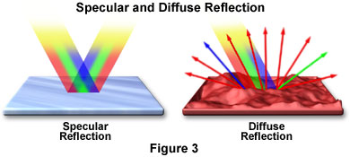
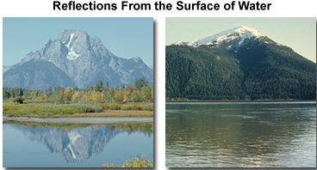
two examples
Physics H8 Light

