Slide 1
The mirror image
The mirror image

Slide 2
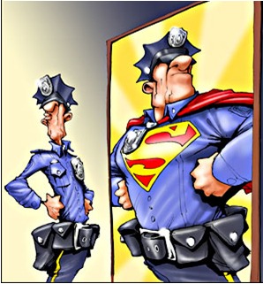
The mirror image
How do you draw a good mirror image?

Slide 3
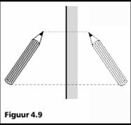
The mirror image
Two important characteristics:
A straight line perpendicular on a mirror goes right through an imaginary line.
The object is located at the same distance from the mirror as the image.

Slide 4
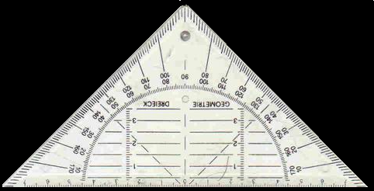
Light
How do you draw a good mirror image?
Q
Q’
Measure the distance
Just as far on the other side
P
P’
R
R’
Object
Image
mirror

Slide 5
DO EXERCISES
67 to 69 (incl.)
T
H
67 to 70 (incl.)
A
57 to 60 (incl.)
Exercise T
Exercise H
Exercise A

