Slide 2
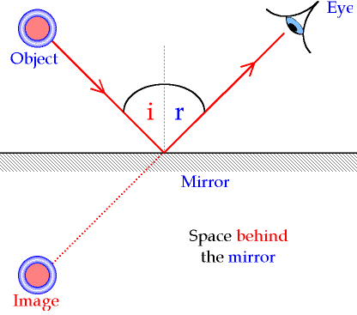
Light
Important characteristics:
Distance of object is distance of image.
You look at the image.
You draw a line from the object to the mirror.
Draw the arrow for the direction of the light.

Slide 3
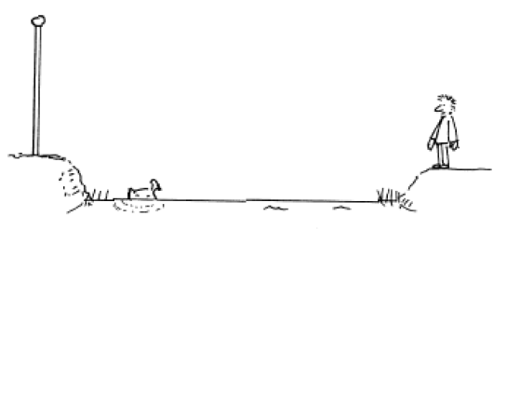
How do you draw the direction of a lightbeam?

Slide 4
There are two important rules.
How do you draw the direction of a lightbeam?

Slide 5
Rule 1
How do you draw the direction of a lightbeam?
Distance of object = distance of image
Perpendicular dotted line on the mirror.
Indicate the image of p with a ‘p’
Tip: Always extend the mirror.

Slide 6
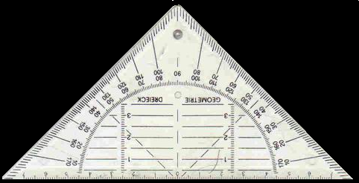
Draw the line of vision how he sees points p and q
How do you draw the direction of a lightbeam?
P
O
P’

Slide 7
2) Light comes to the eye from the mirror image (P’)
How do you draw the direction of a lightbeam?
P
O
P’

Slide 8
3) The original light comes from the object to the mirror.
How do you draw the direction of a lightbeam?
P
O
P’

Slide 9
4) Draw the arrows towards the eye.
How do you draw the direction of a lightbeam?
P
O
P’

Slide 10
The light from the object goes from the eye to the mirror image (O’)
How do you draw the direction of a lightbeam?
P
O
O’
P’

Slide 11
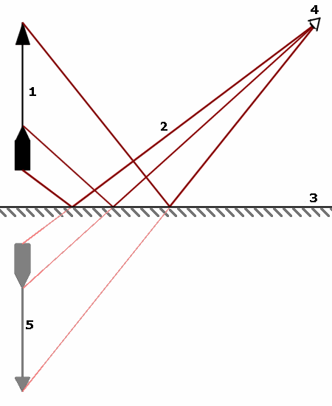
Rule 2: Light lines
Light lines come from the object come notionally from the image and vice-versa.

Slide 12
Do exercise
Exercise
73
T
H
73
A
64
Exercise T
Exercise H
Exercise A

