Slide 1
Mirror
The field of vision via a mirror

Slide 2
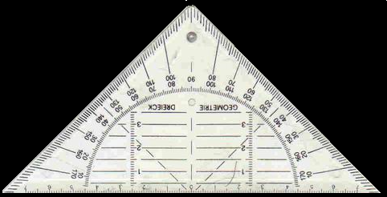
LIGHT – The field of vision
Mirror view
Your field of vision via a mirror
e
e’
mirror
neighbour
wall

Slide 3
Your field of vision via a mirror
mirror
O’
O

Slide 4
Do the exercises
Drawing view lines
T
H
11,12,13
A

Slide 5
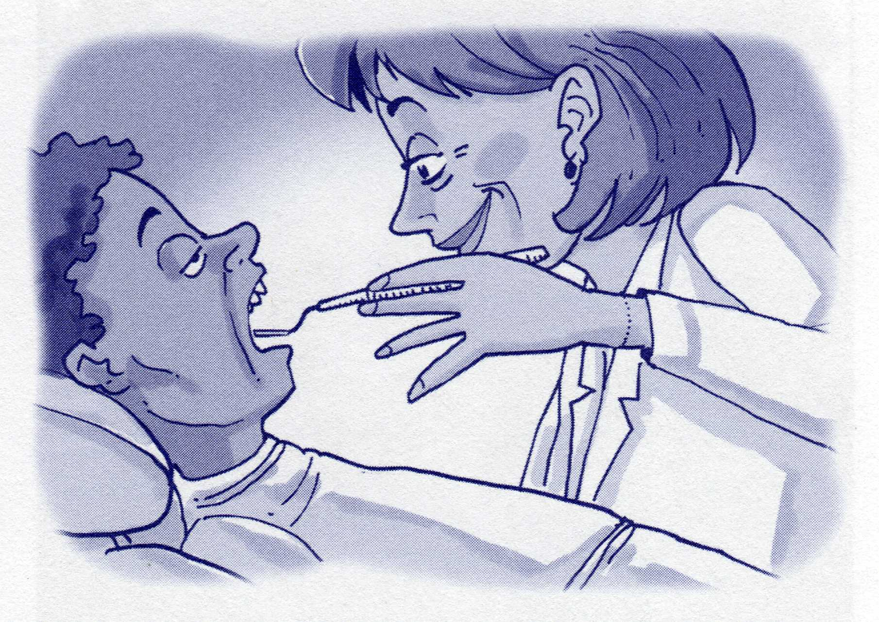
The field of vision

Slide 6
Finish of the exercises in the workbook.
Vision

